Slide 1
the future of careers work
propositions in search of professionalism
to help you with…
> re-making the deal: protecting work-place integrity
> winning the credibility: earning trust and reforming expertise
> enlarging the role: integrating learning for integrated lives
> sharpening the image: developing a narrative of what we do
> pushing the boundary: managing control and finding space
DVT
15
professionalism
updated 20/10/11
this presentation
at:
http://bit.ly/o4wRFV
monograph
at:
http://bit.ly/ofrabV

Slide 2
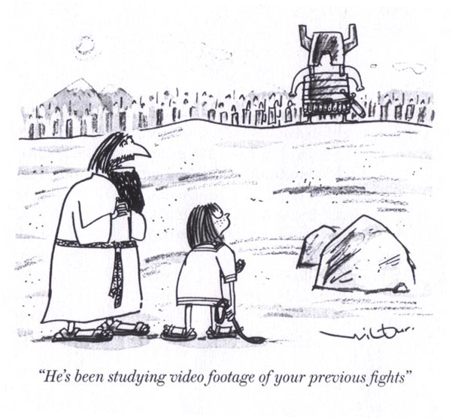
making the deal protecting work-place integrity
independent professionalism needs comprehending support

Slide 3
making the deal protecting work-place integrity
independent professionalism needs comprehending support for. . .
> personal commitment
> institutional support
> versions of professionalism
‘what people do we need to attract into careers-work professionalism?
‘how do we negotiate that in our workplaces?’
‘. . . on the basis of what support for professionalism?’

Slide 4
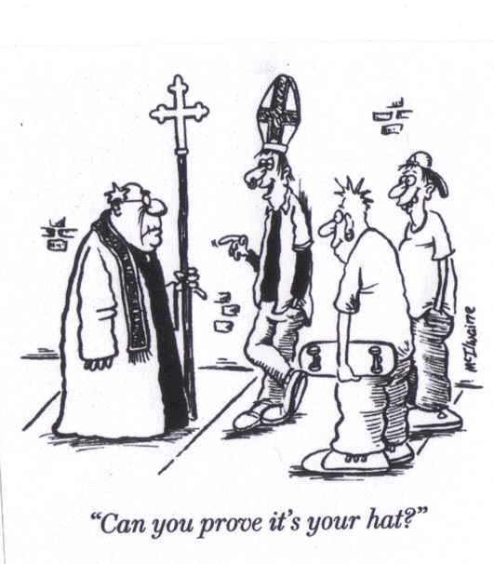
winning credibility earning trust
credibility cannot be claimed, it must be earned

Slide 5
winning credibility earning trust
credibility cannot be claimed, it must be earned among. . .
> culture and its enclaves
> contested claims
> enlarged expertise
‘who collates our understanding of career - and the causes of career’
‘how do we best connect that expertise to client and student experience?’
‘how do they know us - and become known by us - enough to trust us?’

Slide 6
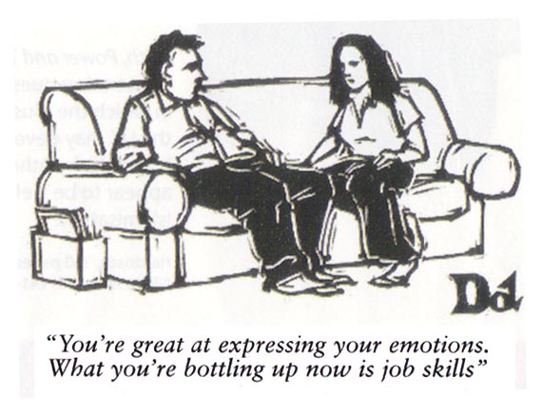
enlarging the role integrating learning for integrated lives
careers-workers professionals know more than they are in a position to use

Slide 7
enlarging the role integrating learning for integrated lives
trained careers workers know more than they are in a position to use in . . .
> learning space for useful action
> finding meaning and purpose
> employability a by-product
‘is a what-to-do gain all that is asked for - or needed?’
‘how do we best help with seeking meaning and purpose?’
‘what can we do about negotiating an integrated curriculum?’

Slide 8
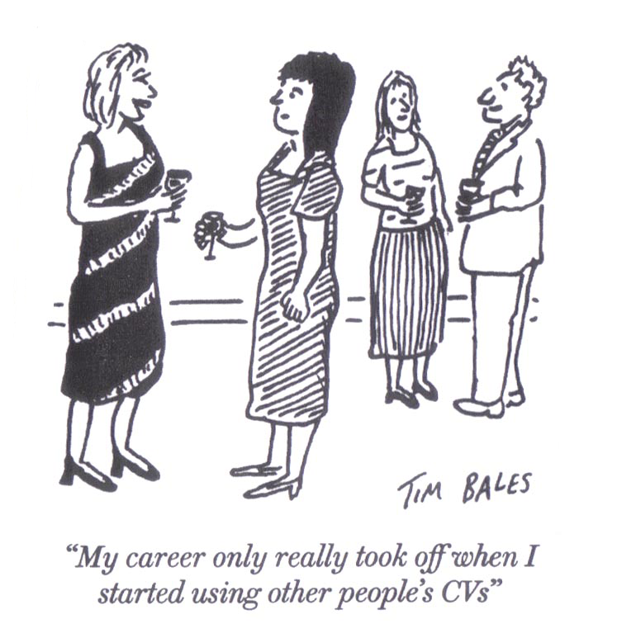
sharpening the image developing a narrative of what we do
careers work is in danger of being marginalised in its own field

Slide 9
sharpening the image developing a narrative of what we do
careers work is in danger of being marginalised in its own field because of . . .
> the ‘race’ is only part of the ‘journey’
> a person, encountering others, in a sequence
> re-balancing face-to-face and progressive learning
‘in how many ways is career management a life-wide life-long journey?’
‘how do we use narrative to connect our expertise to that experience?’
‘what does that mean for re-balancing face-to-face and progressive learning?’

Slide 10
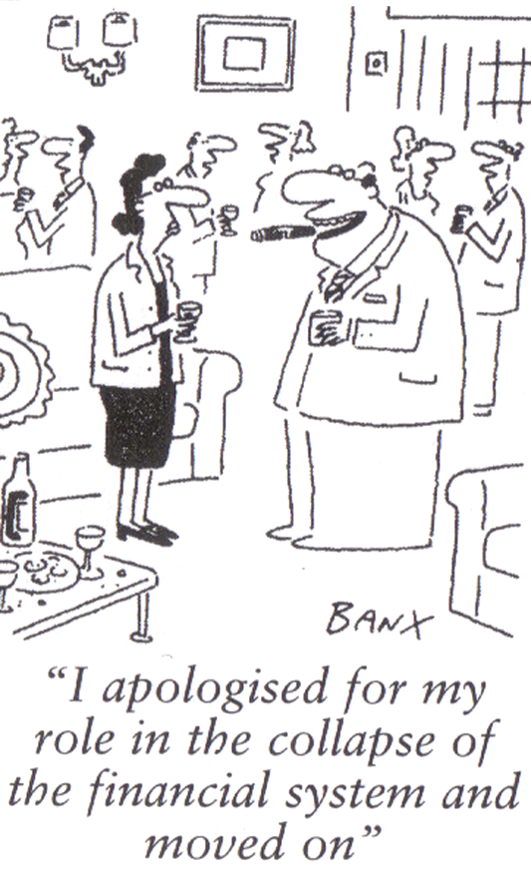
pushing the boundary managing control and finding space
boundary setting is a covert form of control

Slide 11
pushing the boundary managing control and finding space
boundary setting is a form of covert control on. . .
> the personal and the planetary
> students and clients pushing back boundaries
> whether the big society is big enough
‘who has a stake in careers work?’
‘which of their interests should be our interests?‘
‘how do we manage those boundaries on what we do?’

Slide 12
any hope here?
helping you in. . .
. . . re-making the deal: protecting work-place integrity
. . . winning the credibility: earning trust and reforming expertise
. . . enlarging the role: integrating learning for integrated lives
. . . sharpening the image: developing a narrative of what we do
. . . pushing the boundary: managing control and finding space
yes/no
yes/no
yes/no
yes/no
yes/no
if ‘yes’ - glad it’s useful if ‘no’ - tell Bill why at www.hihohiho.com
this ppt . . . www.hihohiho.com/magazine/features/cafprofessionalism.ppt
the monograph . . . www.hihohiho.com/magazine/features/cafprofessionalism.pdf
the lecture - on-line . . . cloudworks.ac.uk/cloud/view/5868
the lecture - portable . . . www.hihohiho.com/magazine/features/cafpropositions.pdf
help colleagues . . . copy-&-paste urls into an e-mail
hiho alerts . . . e-mail ‘yes’ to bill@hihohiho.com
news and updates . . . www.twitter.com/billaw

